Slide 1

Postsecondary Education Quality Assessment Branch
Introduction to PEQAB's quality assurance practices
www.peqab.ca

Slide 2

Quality assurance in higher education refers to policies, procedures and processes aimed at ensuring quality in various aspects of universities and colleges. This includes reviewing providers, academic programs, teaching practices, student support services, and administrative functions to uphold standards and achieve desired learning outcomes.

Slide 3
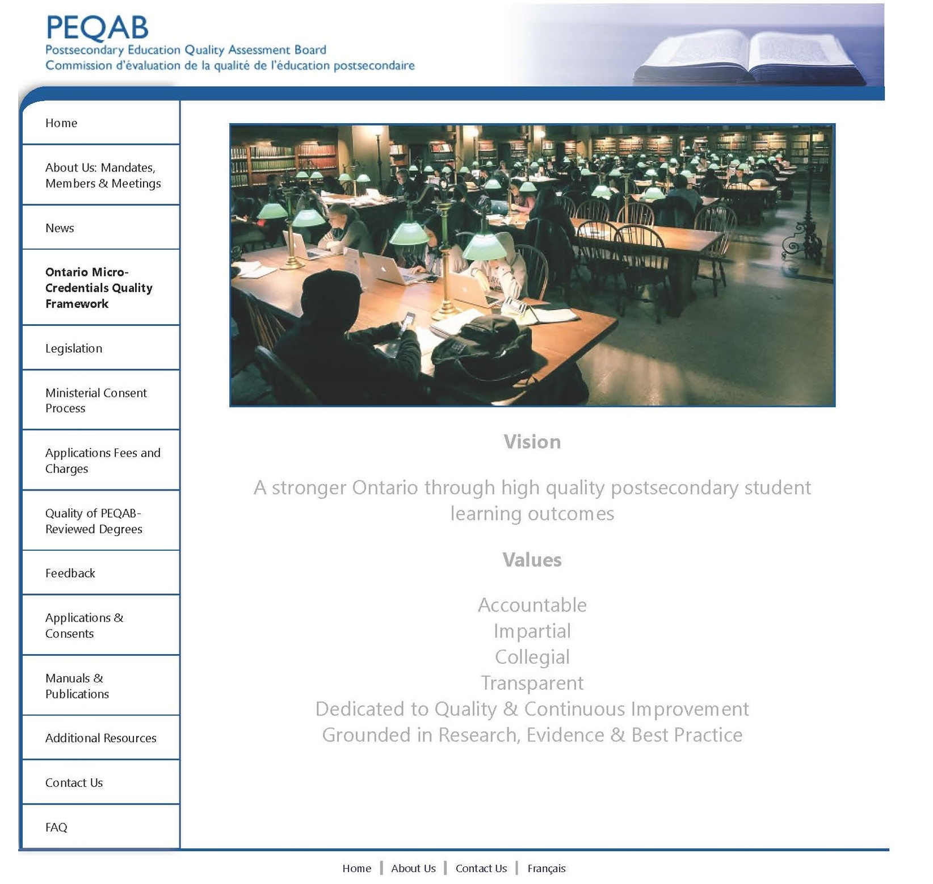
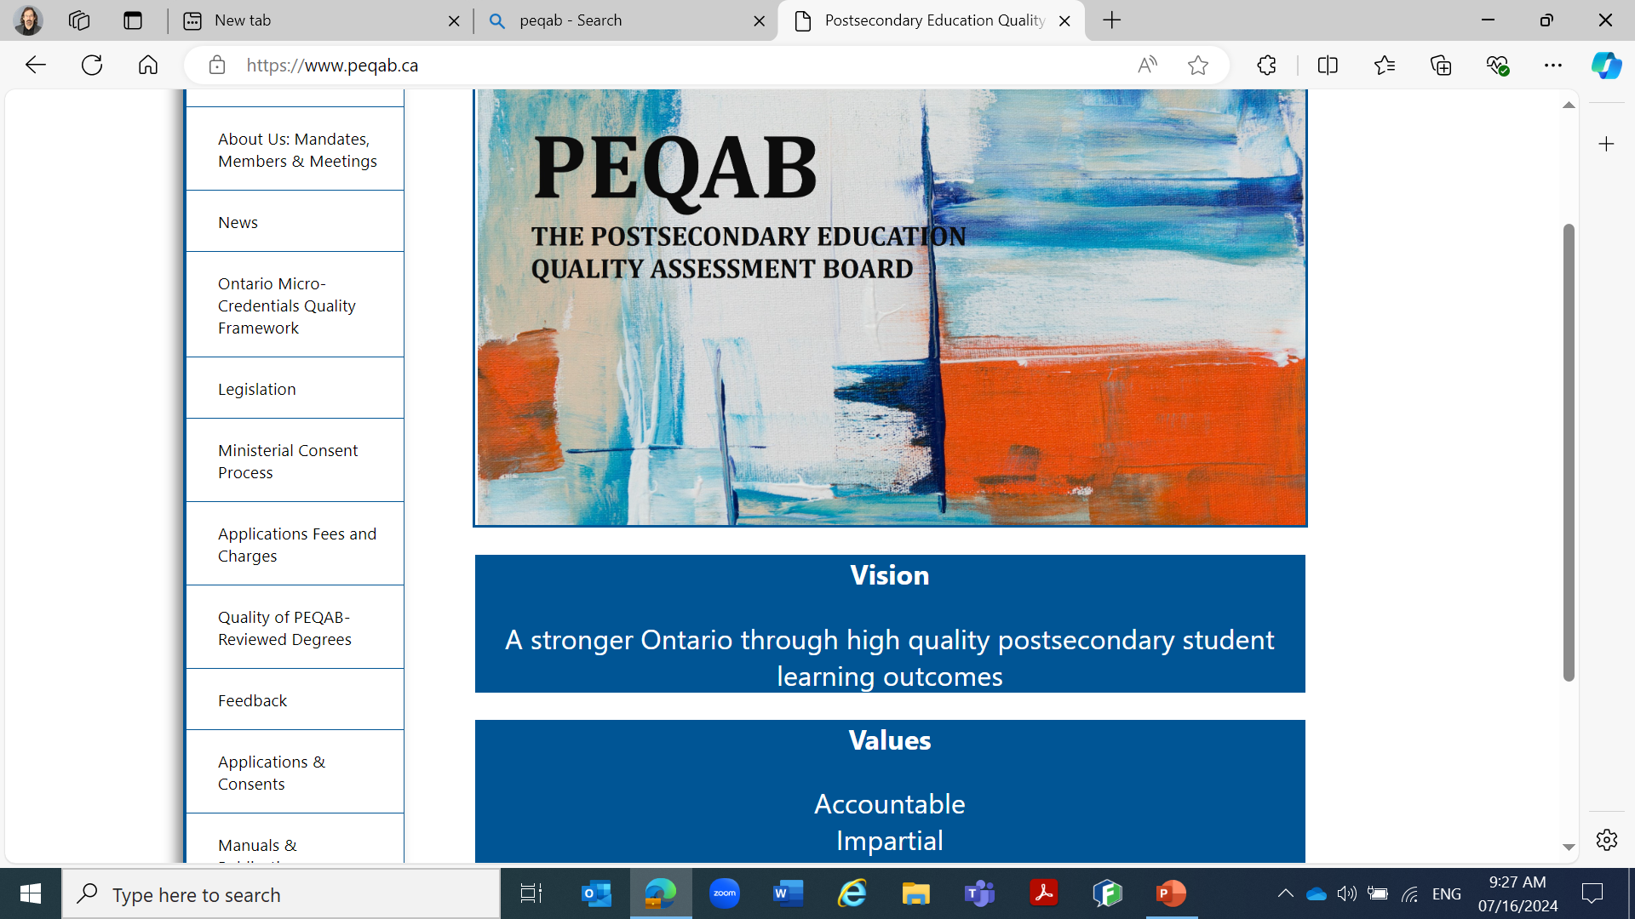

Slide 4

Overview
Legislation
  Post-secondary Education Choice & Excellence Act, 2000
PEQAB Board
  Mandate
PEQAB Branch
  PEQAB Board Secretariat
    Degrees
    Recent Initiatives
    French Language Institutions
    Research matters
  Program Standards (non-degree)

Slide 5
Establishes the Postsecondary Education Quality Assessment Board (PEQAB)
Mandates the PEQAB Board
  To make recommendations to the Minister for “consent” to offer degree programs in Ontario for
    Ontario Colleges offering degrees
    Out of Province universities /institutions
    Private universities/institutions in Ontario
Legislation: PSECE Act
Post-secondary Education Choice & Excellence Act, 2000 (PSECE)

Slide 6
Legislation: PSECE Act
PSECE mandates the PEQAB Board
To establish its own procedures to review applications
To establish its own “criteria” standards and benchmarks for such reviews
To establish review panels to assess the educational quality of proposed degree programs in Ontario and to review applications
To perform such other duties as may be prescribed by the Minister/Ministry
To undertake research as it determines necessary to carry out its duties
To maintain criteria “in accordance with standards recognized in Ontario and other jurisdictions.”

Slide 7
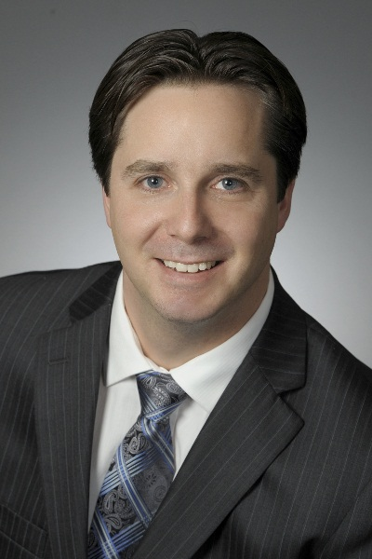
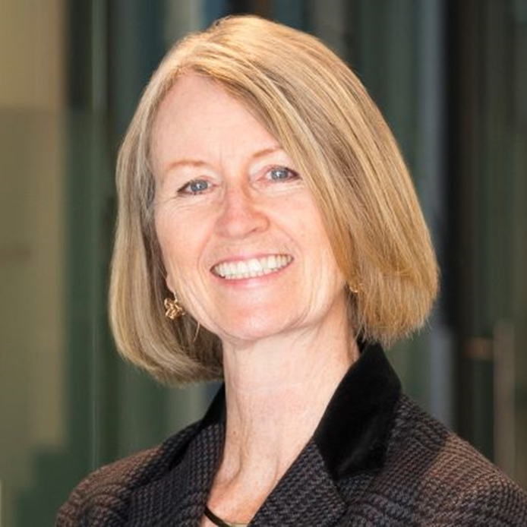
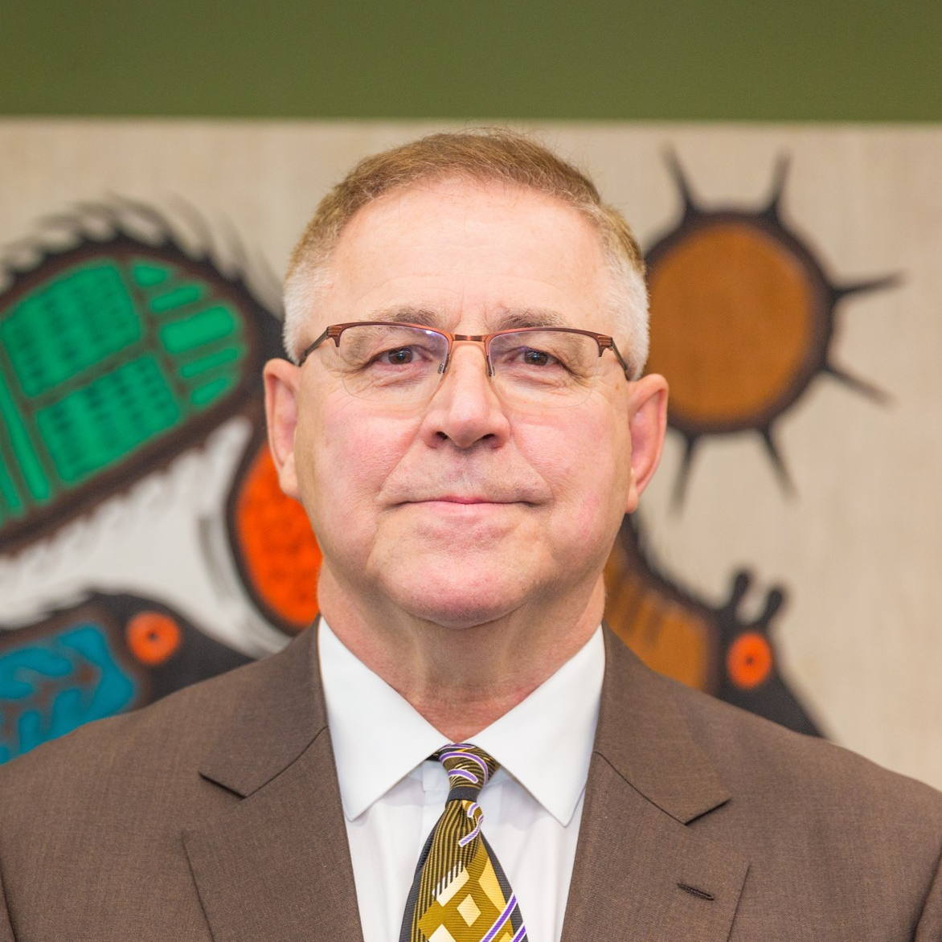

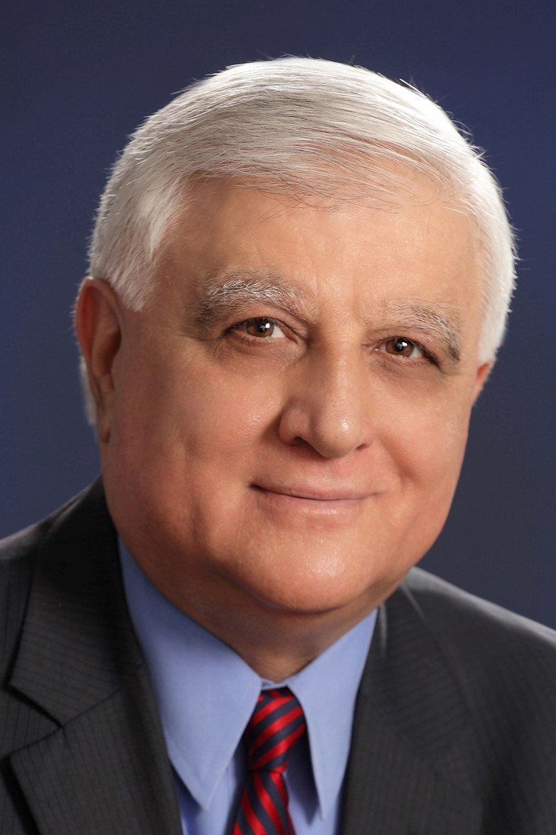
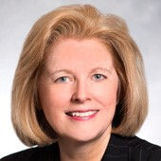
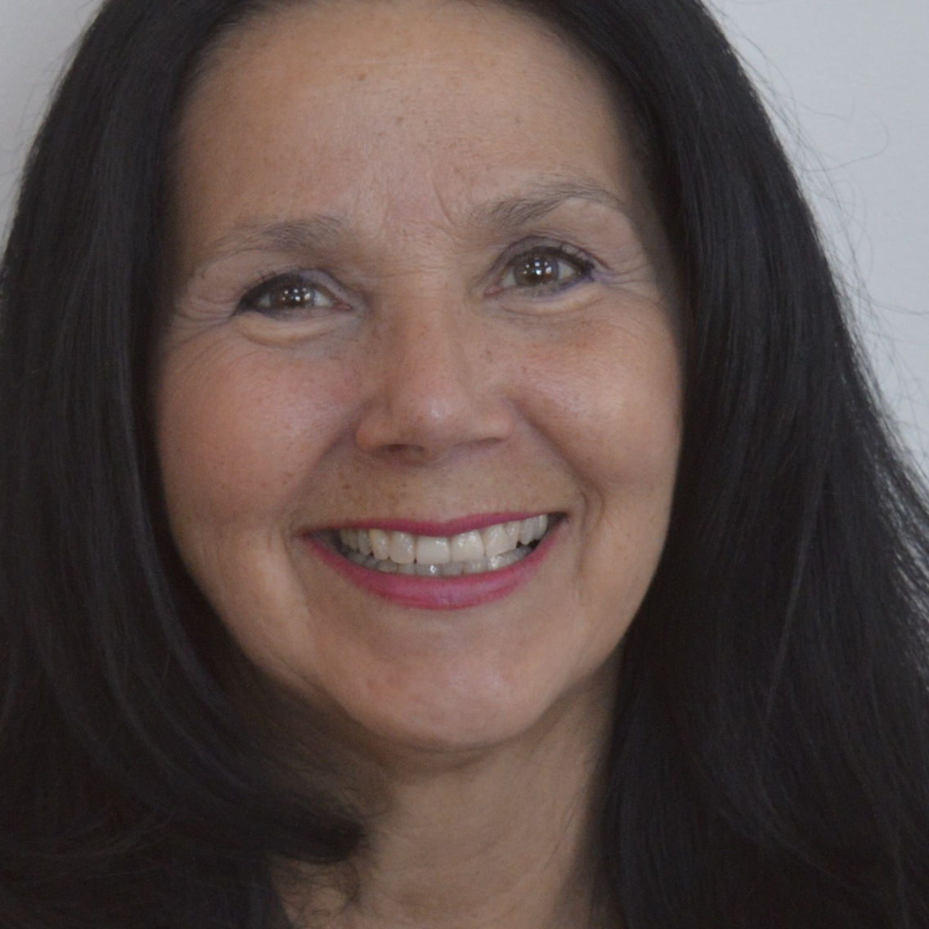
Alex Laurin
Linda Frankln
Armand La Barge, PhD
Appointed Board members
Marnie MacDougal
Thamir (Tom) Murad, PhD
Patricia Southern
Pamela Williamson, PhD

Slide 8
PEQAB Secretariat
As established by the Ministry under a Memorandum of Understanding with the Board, recently revised as a
Terms of Reference, the PEQAB Secretariat:
Organization
Facilitates with the postsecondary sectors in Ontario and abroad understanding of quality assurance and PEQAB processes
CEO
3 Senior Policy Advisors
1 Research Policy Analyst
1 Operations Coordinator
Manages the submissions for consent to offer degrees in Ontario from initial inquiry, through referral to recommendation
Supports postsecondary quality related Ministry initiatives
Revision of Ontario Qualifications Framework (OQF)
Minister’s Directive to Lead Development of Quality Assurance Framework for Micro-Credentials

Slide 9
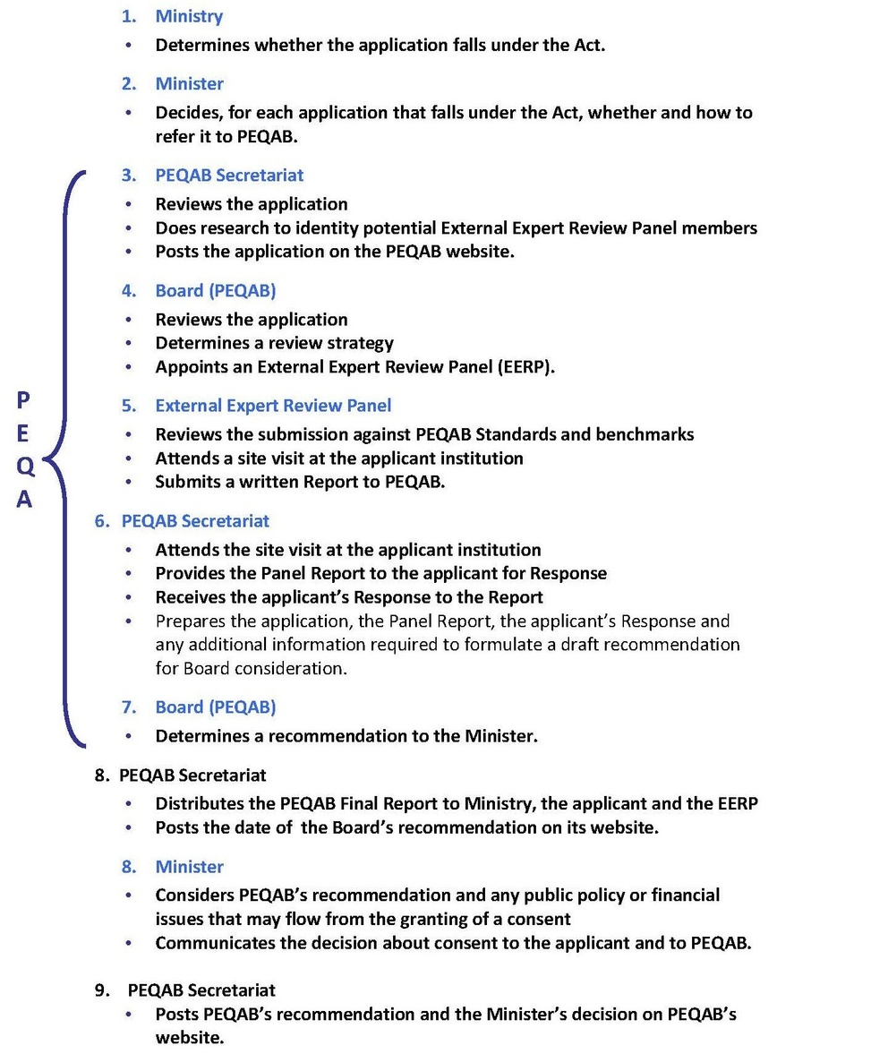
Overview of Consent Process
New Programs
Renewals

Slide 10
PEQAB Secretariat: Types of Reviews
Program Reviews – New & Renewal
  All institutions: consent is fundamentally consent to offer a degree program
Organization Reviews – New & Renewal
  First step in application from a Private institution
Expedited Program Reviews – Renewal
  Institutions with good track record of quality
System Coordination Reviews – New & Renewal
  Private institutions
Breadth Reviews – New & Renewal
  All institutions: review of the non-core curriculum
Report Back Reviews
  Reports back to PEQAB on meeting conditions of consent
Amendment Reviews
  Applications for significant changes during consent
Use of the Term “University” Reviews

Slide 11
French-Language Institutions (FLIs) at PEQAB
Two Ontario Colleges of Applied Arts and Technology (CAATs) are designated under the French Language Services Act, 1990. PEQAB is responsible for the quality assurance of their proposed degree programs:
Collège Boréal (Sudbury and Toronto), currently has consent or is under PEQAB’s review for the following programs:
  Honours Bachelor of Science in Nursing
  Honours Bachelor of Business Administration*
  Bachelor of Business Administration*
  Honours Bachelor of Public Administration*
  Honours Bachelor of Computer Science*
  Bachelor of Computer Science*
Collège La Cité (Ottawa), currently has consent or is under PEQAB’s review for the following programs:
  Honours Bachelor of Biotechnology
  Honours Bachelor of Science in Nursing
  Honours Bachelor of Commerce – Management*
  Bachelor of Commerce*
  *signifies program under PEQAB’s review
Ten public universities, affiliated universities or faculties offer French-language or bilingual education under the Act in Ontario.
PEQAB oversees quality assurance for the following public Ontario French-language universities:
Université de l’Ontario français (Toronto) currently has consent or is under PEQAB’s review for the following programs:
  Honours Bachelor of Business Administration
  Honours Bachelor of Mental Health
  Honours Bachelor of Social Work*
  Honours Bachelor of Education
  Honours Bachelor of Digital Cultures
  Honours Bachelor of Human Plurality
  Honours Bachelor of Globalized Economies
  Honours Bachelor of Urban Environments
Université de Sudbury (Sudbury)
  Organization Review only
PEQAB has also worked with other public, private or out-of-province French-speaking institutions as required:
  Université Saint-Paul affiliated with the University of Ottawa
  Université Hearst
  Dominican University College

Slide 12


PEQAB process for FLIs
To support French-language institutions, PEQAB completes all steps of the Review in French the same way that Reviews are completed in English. This means that PEQAB:
Recruits and works with French-language subject matter Experts
Communicates with francophone institutions in French
Materials are finally translated into English for the Board
Completes sites visits in French
Receives all institutional submissions in French
Produces all supporting materials in French

Slide 13

PEQAB Secretariat: Canadian Outreach
Coordinates a monthly meeting of all Canadian quality assurance agencies:
Consults with postsecondary sector groups
Facilitates potential applicants’ understanding of PEQAB Standards & processes
•British Columbia Degree Quality Assessment Board (DQAB)
•Campus Alberta Quality Council (CAQC)
•Maritime Provinces Higher Education Commission (MPHEC)
•Ontario Universities Council on Quality Assurance (OUCQA)
•Ontario College Quality Assurance Service (OCQAS)
•Saskatchewan Higher Education Quality Assessment Board (SHEQAB)
•Conseil superieur de l’education Quebec, Commission on University Education & Research (CSE)
•Northwest Territories
College Degree Operating Group (CDOG)
Private/Out of Province Degrees in Ontario Group (POPDOG)
•Predetermination Process
•Informal Inquiry Responses

Slide 14

PEQAB Secretariat: Global Community
Active participant in international quality assurance, conferences, and activities, especially through its participation in
International Network for Quality Assurance Agencies in Higher Education (INQAAHE)
Council for Higher Education Accreditation International Quality Group (CIQG)
Presentations at international conferences
International network of approximately 200 organizations active in the theory and practice of quality assurance in higher education.
A forum for postsecondary institutions, accrediting and quality assurance organizations, higher education associations, governments, businesses, foundations, and individuals to address issues and challenges for quality assurance in an international setting
●Consortium of Higher Education Accreditors (CHEA) -- Washington, DC January 2018
●International Network of Quality Assurance Agencies in Higher Education (INQAAHE) -- Kingdom of Bahrain, February 2017
Dr. Mary Catharine Lennon has been an elected member of the Board of Directors of INQAAHE since 2020
●European Quality Assurance Registrar (EQAR) -- Riga, Latvia, November 2017

Slide 15
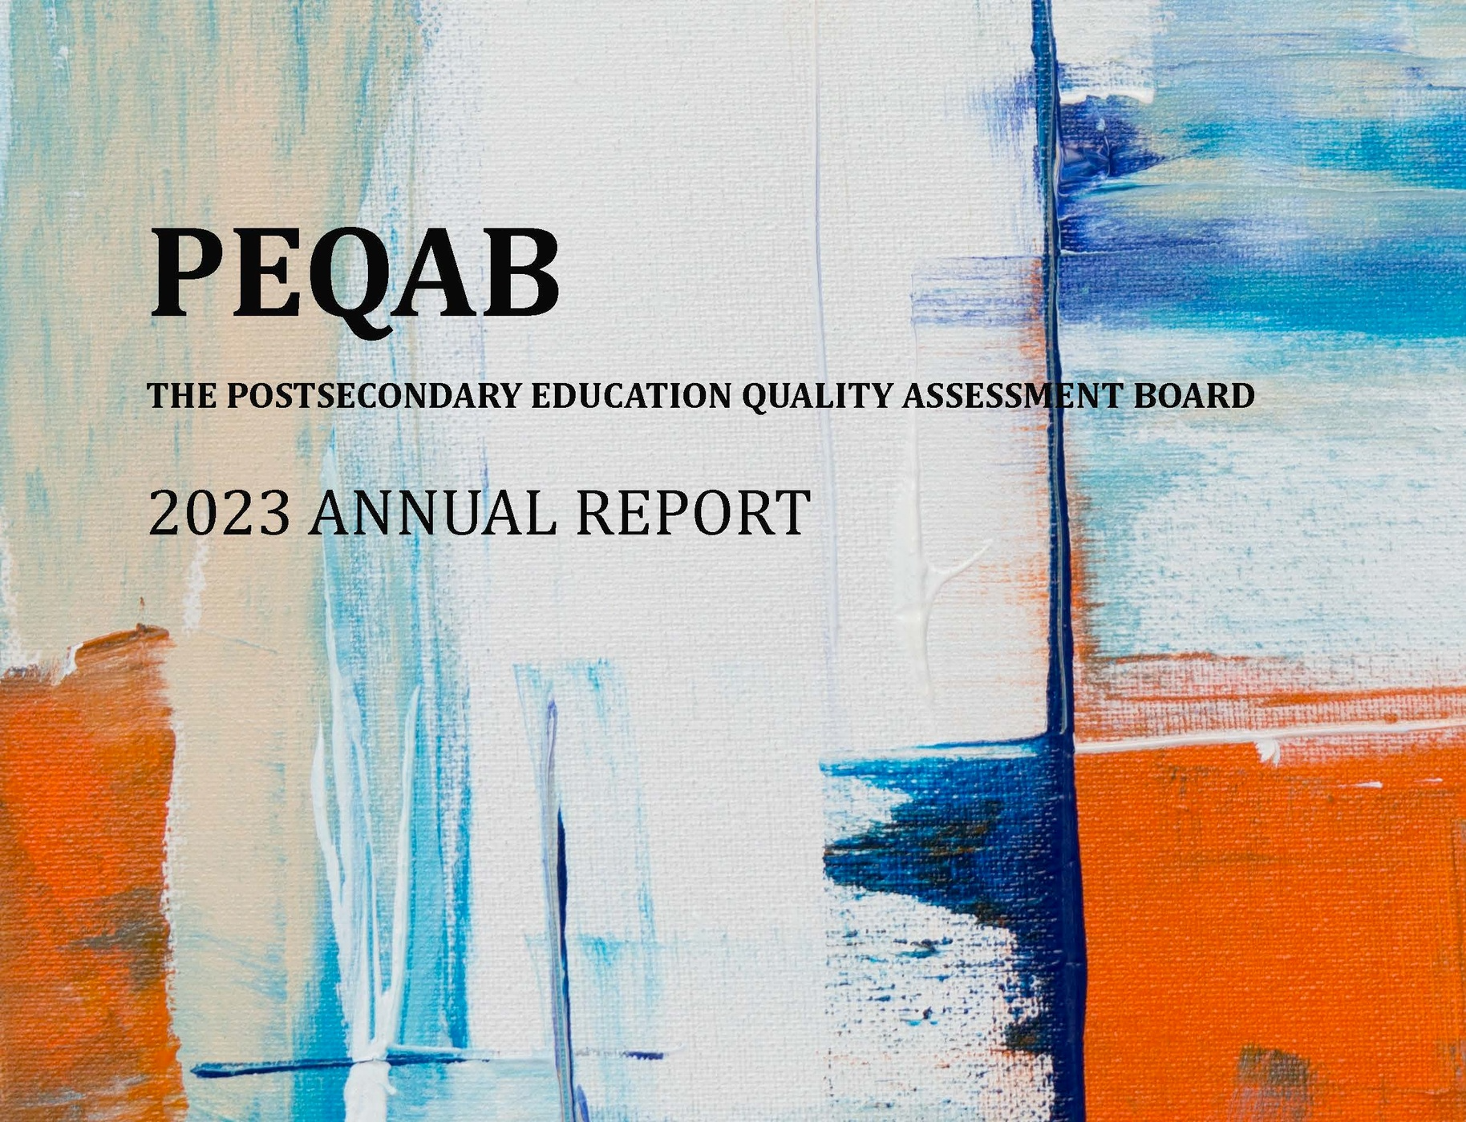
PEQAB Review Activities:
Annual Report
Jan. 1, 2023 - December 31, 2023
Over eleven (11) meetings, the Board made recommendations to the Minister on forty-eight (48) Reviews
The Secretariat managed 57 applications which were in the various stages of the PEQAB process during this year.
Performance Measures
    Satisfaction of Applicants: Benchmark 90% Satisfied or Very Satisfied
    Satisfaction of Expert Panels: Benchmark 90% Satisfied or Very Satisfied
    Timelines: 6 months on average: Missed for the first time—not enough appointed members for quorum for first quarter of 2023.

Slide 16
PEQAB Review Activities:
Annual Report
Between 2021 and 2023 the Board and its Secretariat completed the following initiatives and enhancements.
Terms of Reference:
Indigenous Breadth Programming:
Breadth Capacity Reviews:
On May 26, 2023 with considerable input from PEQAB, Minister Dunlop signed and forwarded to PEQAB a Terms of Reference. The new Terms of Reference provide clarity on the relationship between MCU and PEQAB as an arms-length advisory agency.
At its June 2023 meeting, PEQAB’s Board made mandatory among its requirements for the non-core or breadth programming within all its baccalaureate and honours baccalaureate degrees “Knowledge of Indigeneity, that is First Nations, Metis and/or Inuit cultures.”
Established transparency in PEQAB’s tracking of Breadth Reviews through documenting Full Breadth Capacity Reviews on PEQAB’s public-facing web site at www.peqab.ca/
manaualguidelines.html
Faculty Credentials
Predetermination of Terminal Credentials:
Although a doctorate is normally the terminal academic credential in traditional disciplines, in developing areas of study, a variety of credential packages may be deemed to constitute the terminal credential. For instance, to teach a degree in Culinary Arts it was determined by the Board, on the advice of an EERP, that a Certified Chef de Cuisine plus (any) master’s degree plus relevant experience would constitute the terminal credential “package.”
The Board introduced a “predetermination” process for considering, in advance of a consent application, what the Board will accept as constituting the “terminal credential” for faculty in particular degree fields, especially where there are limited or no doctoral programs. In this connection, the Board has also adopted the concept of “terminal credential packages,” i.e., a determination what combination of credentials held by an individual faculty member, normally in addition to a Masters degree, will comprise the terminal credential

Slide 17




Research and Special Projects
International contributions
Sector-focused research
Ministerial Requests

Slide 18
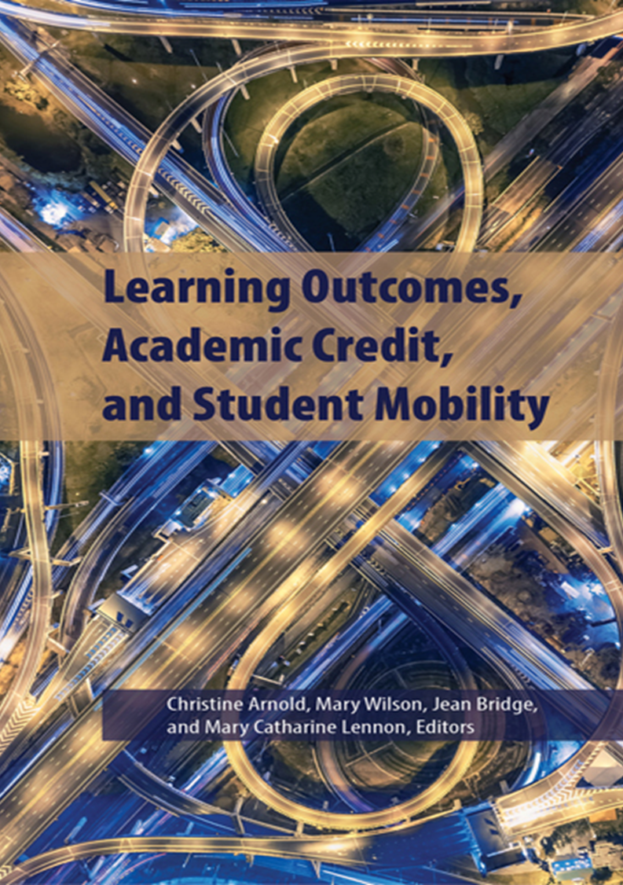
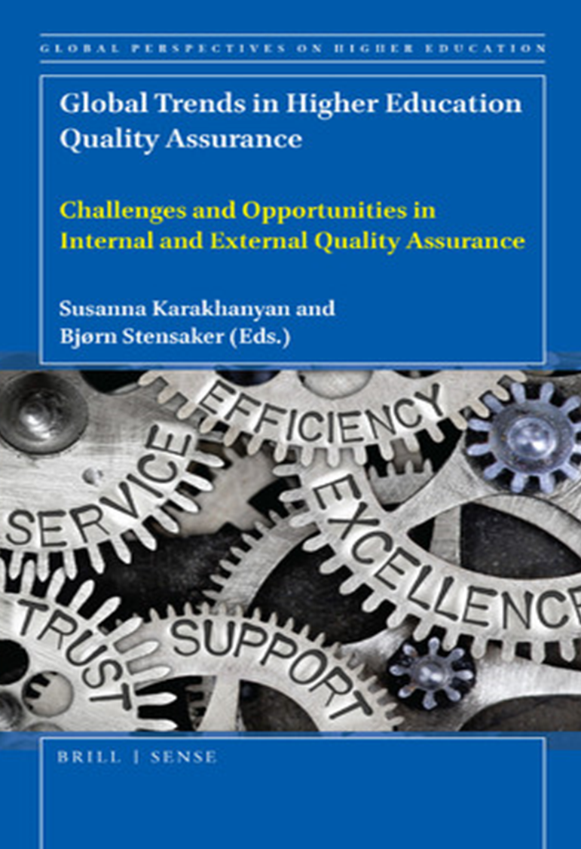
Past publications

Slide 19
Student engagement in quality assurance
College degree alumni in graduate programs
Panel Identification, Recruitment, Orientation and Support Practices
Focused research in partnership with institutions
National survey and report on how students are engaging in academic matters in their institutions.
Institutional data analysis and interviews with alumni regarding their decision making and experiencing in applying to graduate studies.
Provincial survey of quality assurance review panel practices.

Slide 20


Special Projects
UNESCO’s
Lisbon Accord and Global Conventions
Micro-Credential Quality Assurance Framework

Slide 21




The proposed Ontario Micro-credential (OMC) Framework
Qualifications Framework
Quality Assurance
Recognition
Provides transparent parameters of credential expectations
Monitors programming through External Quality Assurance Processes (EQAP) of Internal Quality Assurance Processes (IQAP)
Demonstrates and legitimizes achievments

Slide 22

Program Standards (Non-Degrees)
What is a Program Standard?
Program standards are developed by the Ministry and outlines the minimum expectations of non-degree programs (e.g., Personal Support Worker).
Program standards promote consistency in education/training outcomes across all public colleges (and in some cases, career colleges, school boards and Indigenous Institutes).
1. Vocational Learning Outcomes – specific to program.
Three Components of a Program Standard
2. Essential Employability Skills
3. General Education Requirements

Slide 23
Program Standards (Non-Degrees)
Background
There are 290 program standards (English and French) college programs that exist across several credential levels.
Program standards are reviewed/developed in English and French concurrently.
Where they exist, program standards provide the basis for curriculum development in the college system by:
  Influencing the kinds of learning activities that program faculty design for students and how students are evaluated.
  Providing students with a clear indication of what they are expected to learn and demonstrate.
  Promoting accountability for program quality.

Slide 24
Program Standards (Non-Degrees)
Developing and Updating Program Standards
In the past few years, PEQAB has hired up to 15 Facilitators to conduct on average 30 program standards reviews per review cycle.
A broad-based consultation process is used when developing or updating a program standard involving a wide range of stakeholders with a direct interest in the program area such as:
  Employers
  Professional Associations / Regulatory Bodies / Accreditors
  Other Ontario Ministry’s
  Current and past students
  College faculty / administrators / curriculum developers
Program standards are validated by the Credential Validation Service (CVS) and Skilled Trades Ontario for apprenticeship programs.

Slide 25

Q&A and Discussion
www.peqab.ca
www.ontario.ca/page/college-program-standards

